Slide 1

www.CRISP.nz
Presented by
Group 8

Slide 2
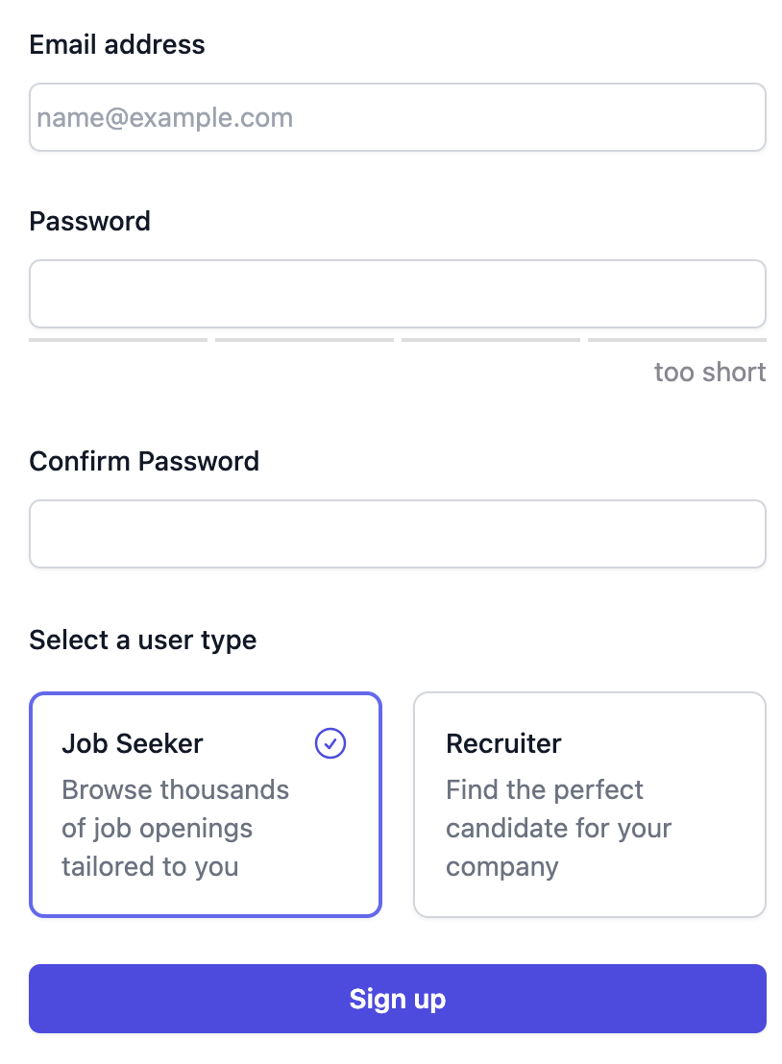
About Crisp
Crisp for Jobseekers.
Crisp for Recruiters.
Notes:
Crisp is designed to facilitate jobseekers in creating personalized profiles, including introductory videos and traditional CVs.
It helps recruiters in posting jobs, evaluating candidates, and maintaining smooth communication throughout the recruitment process.

Slide 3

Project Planning & Delivery
Scrum
Async (Trello & Teams)

Slide 4
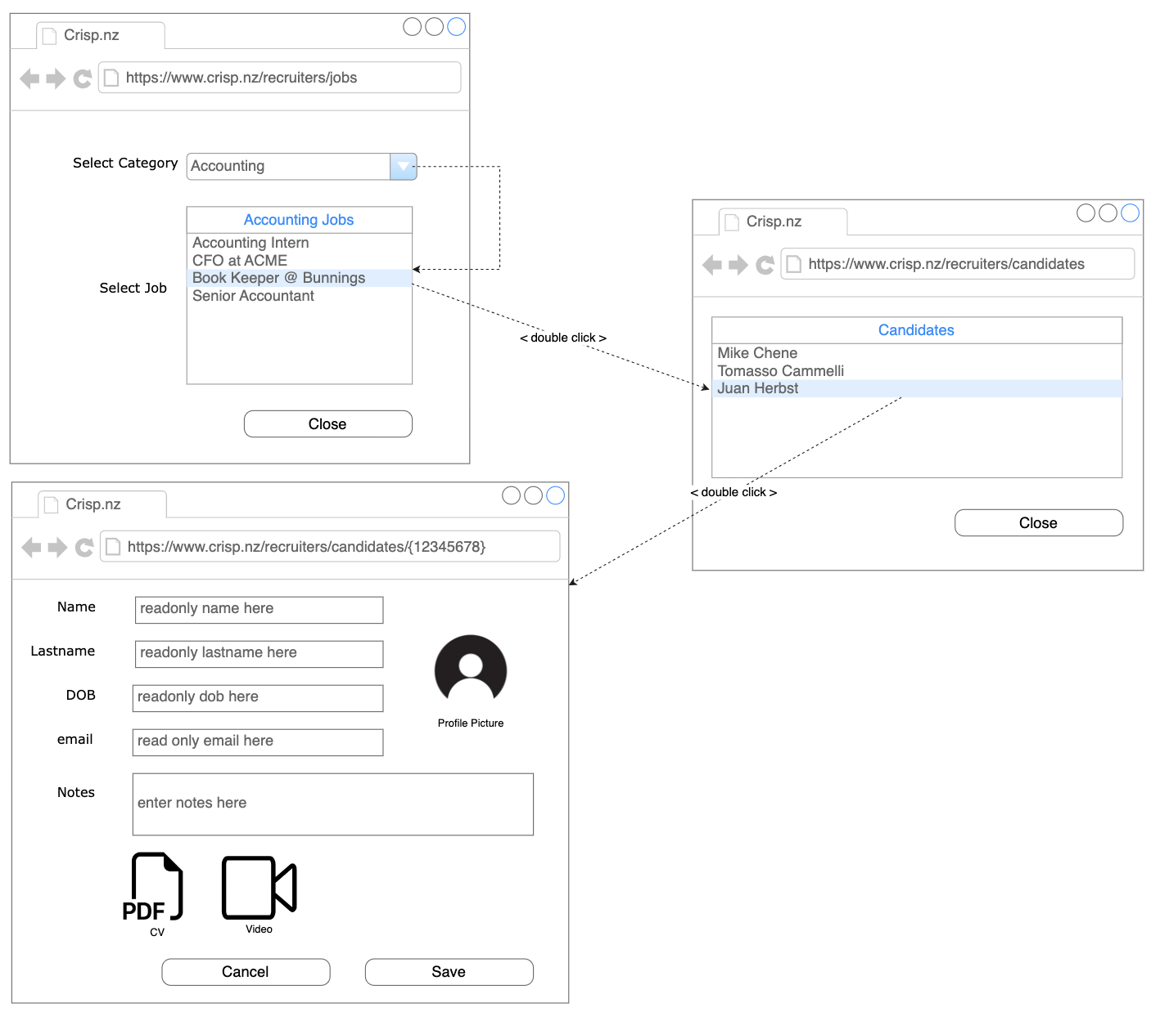
Project Design: UX
Screen Mock-ups
Flow

Slide 5
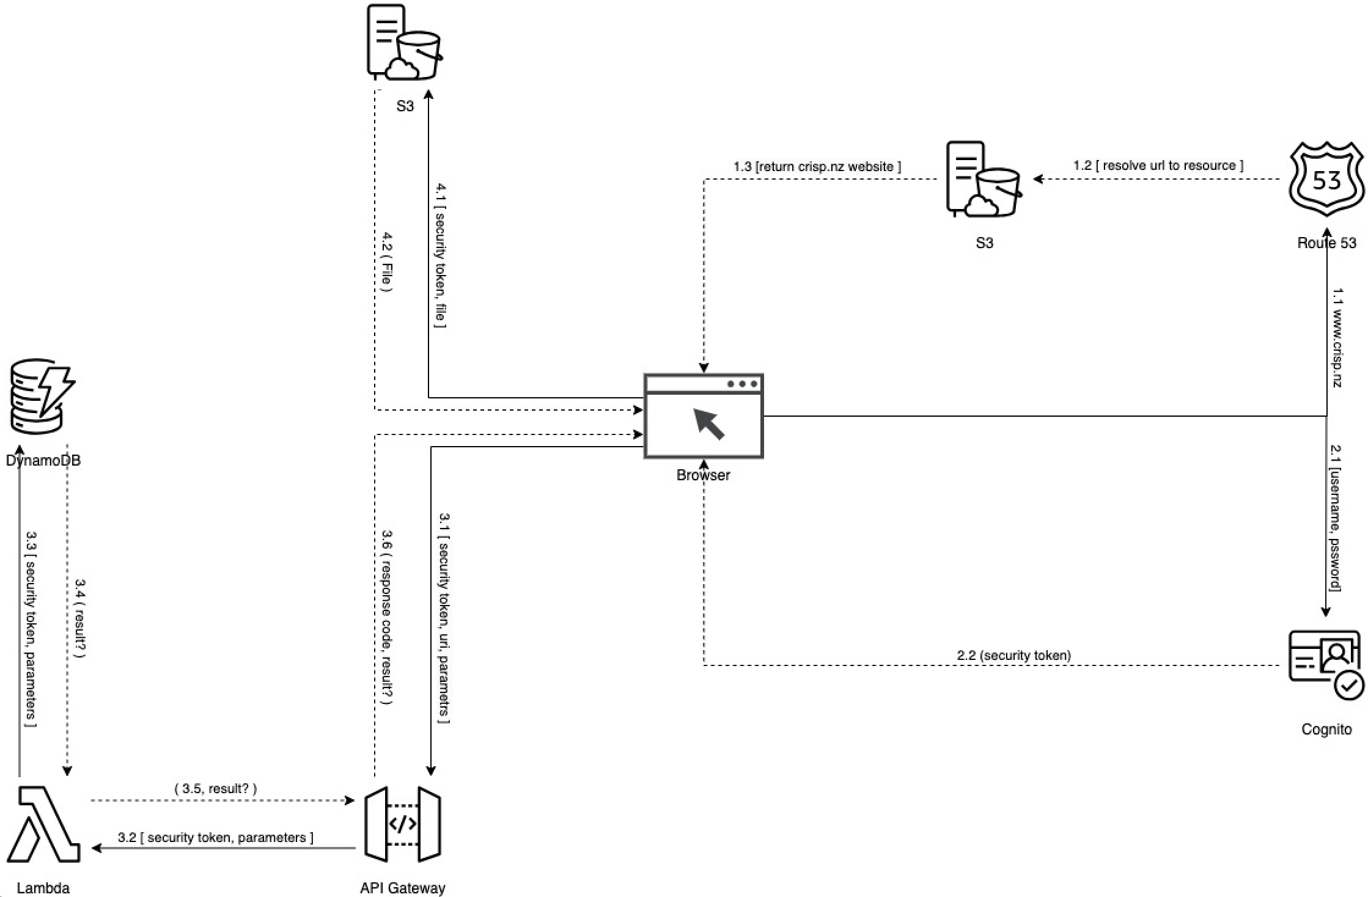
Project Design: Cloud Services & Architecture
Route 53
Cognito
API Gateway
Lambda
DynamoDB
S3

Slide 6
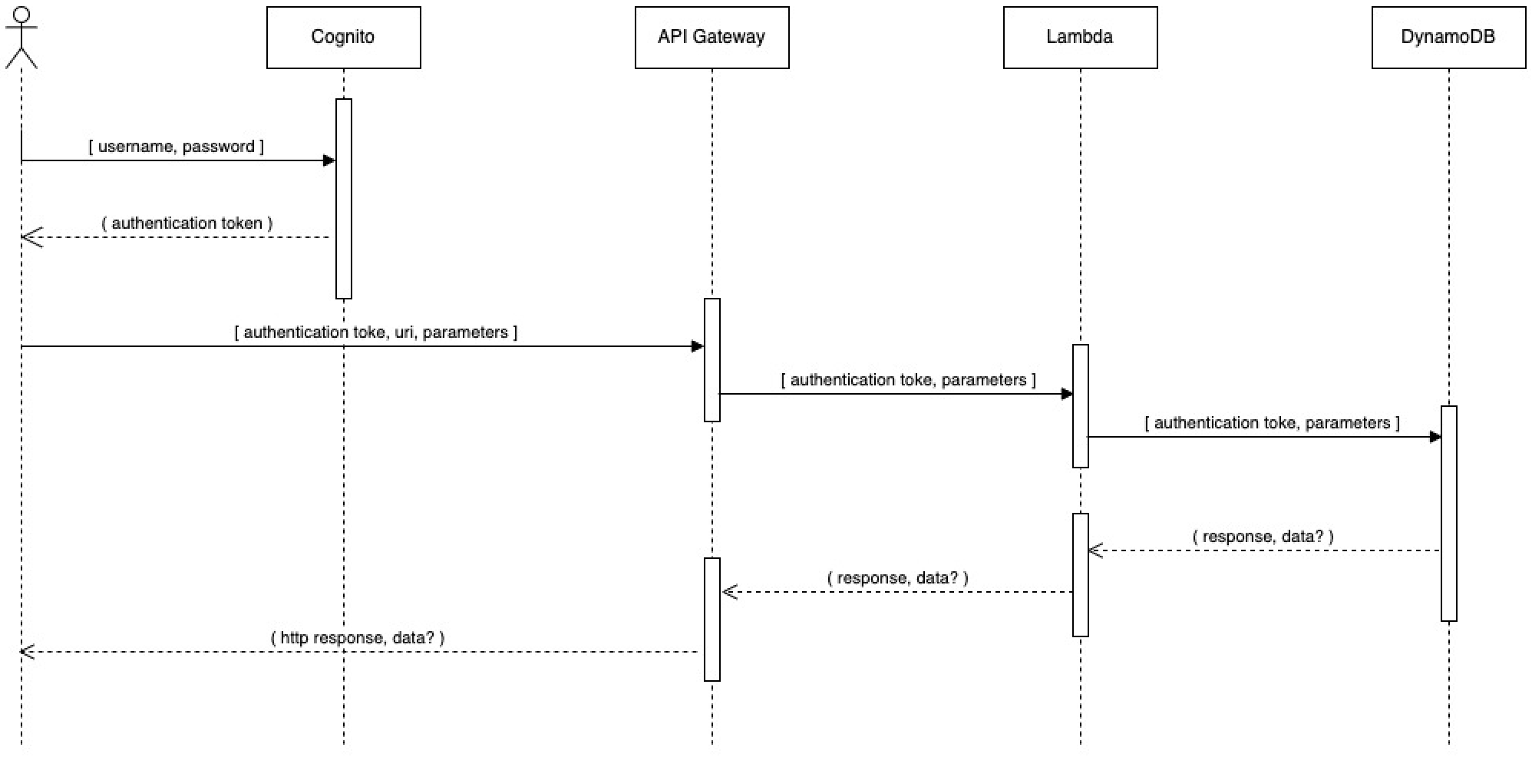
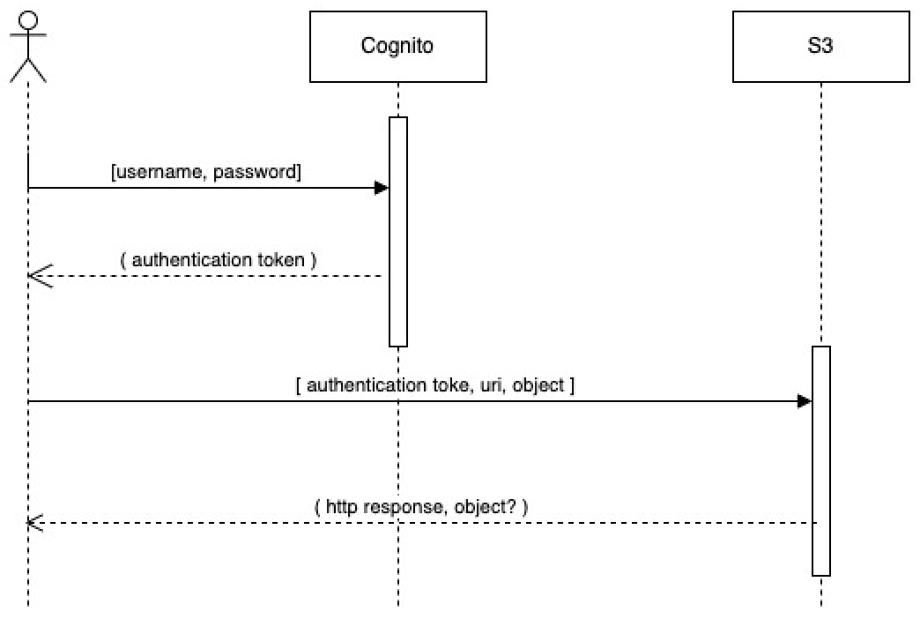
Project Design: Sequence Diagrams

Slide 7
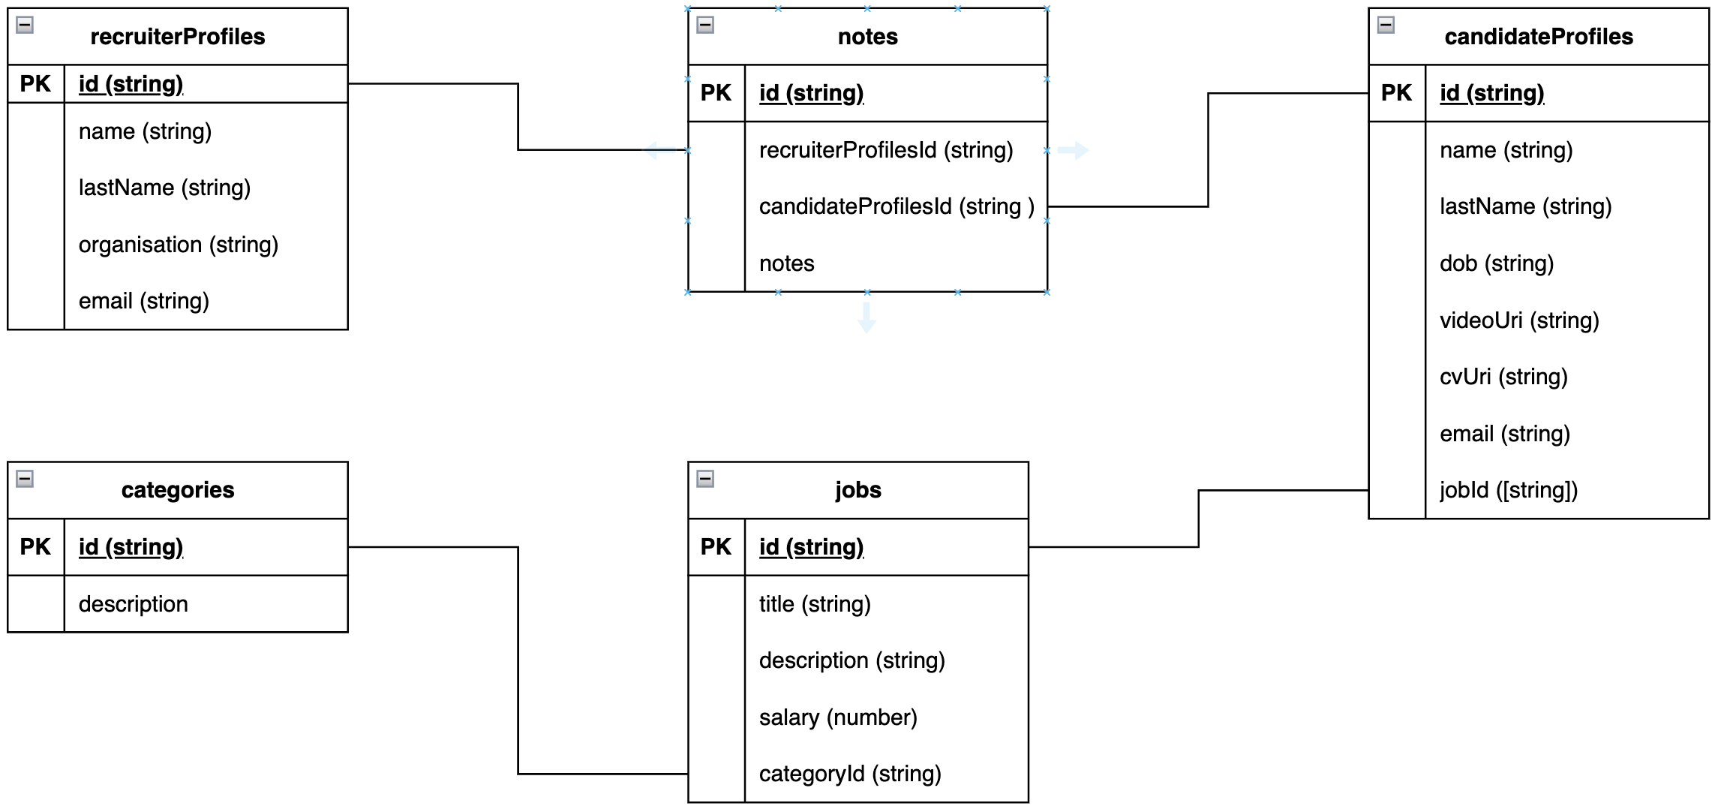
Project Design: Schema Designs
1. { 2. “$schema”: “http://json-schema.org/draft-04/schema#”, 3. "type": "object", 4. "properties": { 5. "id": { 6. "type": "string" 7. }, 8. "description": { 9. "type": "string" 10. } 11. }, 12. "required": [ 13. "id", 14. "description" 15. ] 16. }

Slide 8
RESTful Endpoints
https://api.crisp.nz/
Create
POST https://api.crisp.nz/ noun /
{ body: … }
Read
GET https://api.crisp.nz/ noun / {id}
GET https://api.crisp.nz/ noun /
Update
PUT https://api.crisp.nz/ noun / { id }
{ body: … }
Delete
DELETE https://api.crisp.nz/ noun / {id}

Slide 9
Tech Stack
AWS Amplify (AWS Development Framework)
AWS API Gateway (RESTful API)
AWS Route 53 (DNS)
AWS Cognito (Auth)
AWS Lambda (Serverless Backend)
AWS DynamoDB (NoSQL Database)
AWS S3 (Object Storage)
Node.js
Express (Node.js REST API)
TypeScript
React
Vite
Vitest
GitHub
Tailwind CSS

Slide 10
Summary
3 Tier Architecture using Cloud and Modern Development Frameworks.
CI/CD Deploy via PR into Main Branch

